Slide 1


TEAM 2 - SPOTIFY RECOMMENDER ENGINE -- CAPSTONE PROJECT
- KIAN LEE, ZAYAN KHAN, ANOUSHKA GEORGE, NEEL VENKATESAN

Slide 2

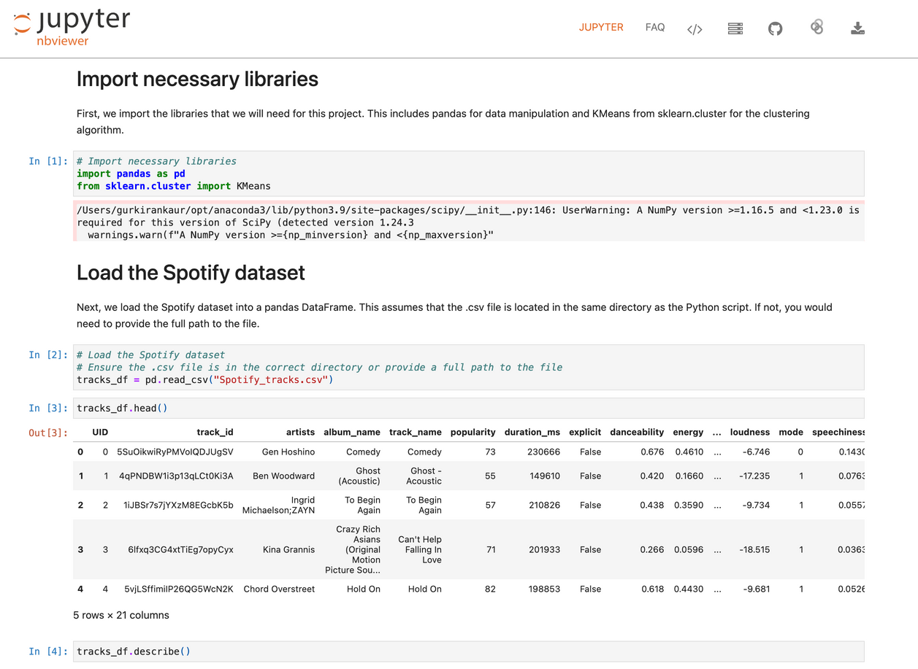
ORIGINAL MODEL
OVERVIEW
Original 11.4 Provided Model:
Reads Spotify_tracks.csv
Cluster the whole catalogue once
Ask the listener for favourites
Find the listener’s cluster
Recommend five songs

Slide 3
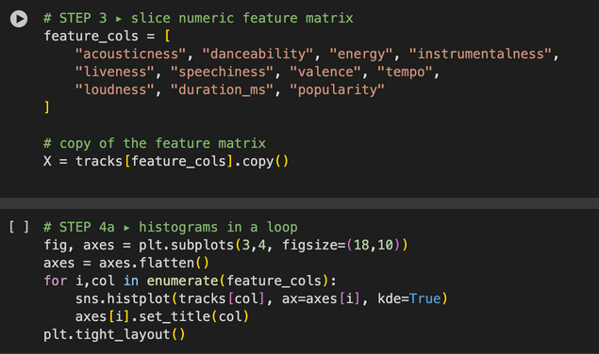
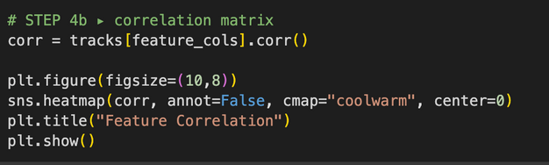
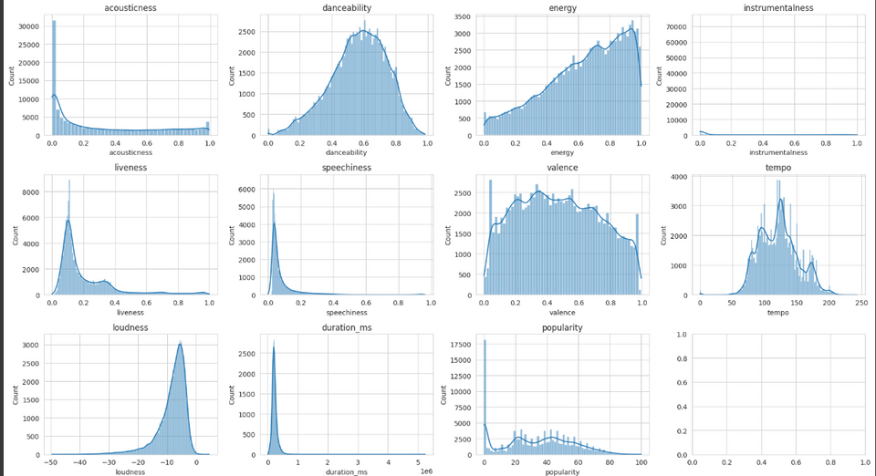
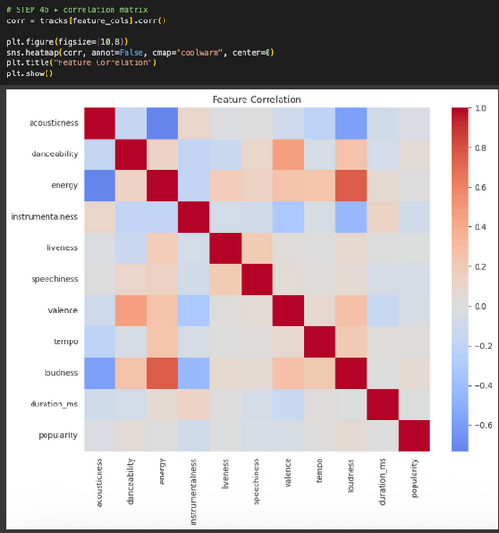
EXPLORATORY DATA ANALYSIS
(EDA)
Before modeling, we explored the distributions and relationships between key audio features by creating histograms for all 11 numeric features to inspect their spread, skewness, and potential outliers and generating a correlation heatmap to identify highly related features.
Key observations:
valence, danceability, and energy show strong positive correlation: suggesting that upbeat songs tend to cluster together.
acousticness is bimodal: songs tend to be either highly acoustic or not acoustic at all.
tempo, loudness, and duration_ms vary widely, indicating a range of musical styles.

Slide 4
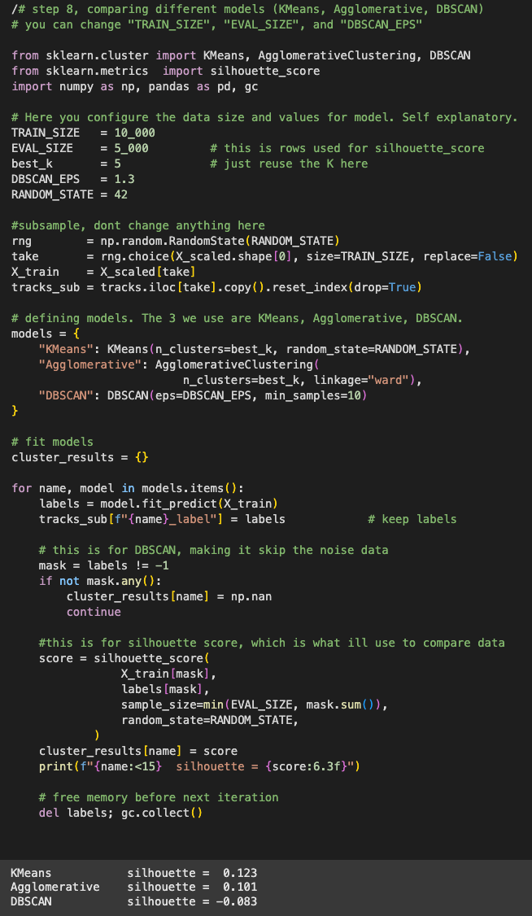
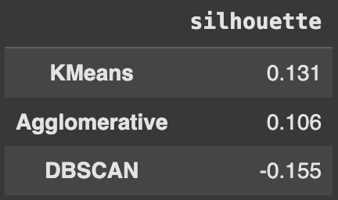
COMPARING CLUSTERING ALGORITHMS
We tested three clustering models to group songs by audio features:
KMeans – clear clusters, and the highest silhouette score (~0.131).
Agglomerative – good results, looser than KMeans
DBSCAN – negative silhouette score, disregard.
KMeans outperformed the others in silhouette score, so we will be using that moving forward.

Slide 5

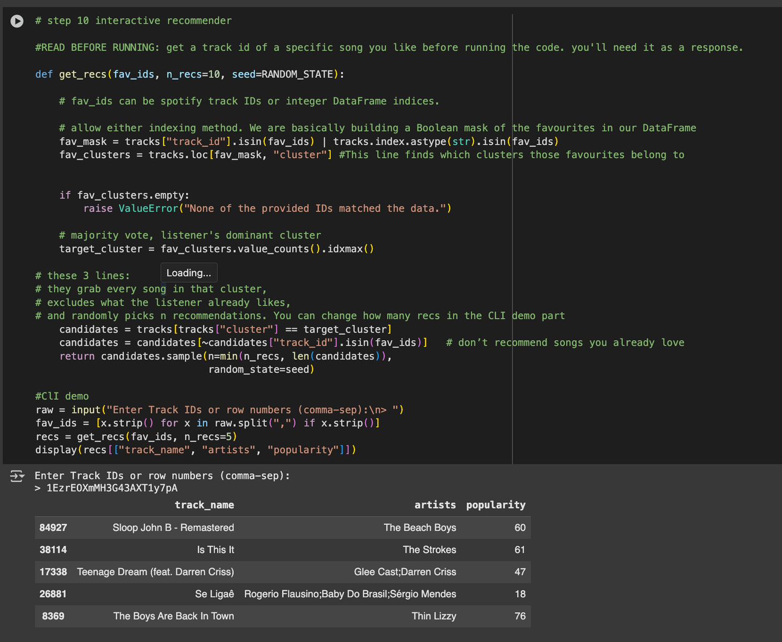
SONG RECOMMENDER
We used MiniBatchKMeans, a memory-efficient version of KMeans, to cluster all songs into five groups based on audio features.
Each song was assigned a "cluster" label, grouping similar-sounding tracks together.
Then we build a simple recommender system: the user enters one or more favorite track IDs, and the system identifies the main cluster.
It returns 5 similar songs from that same cluster.

Slide 6
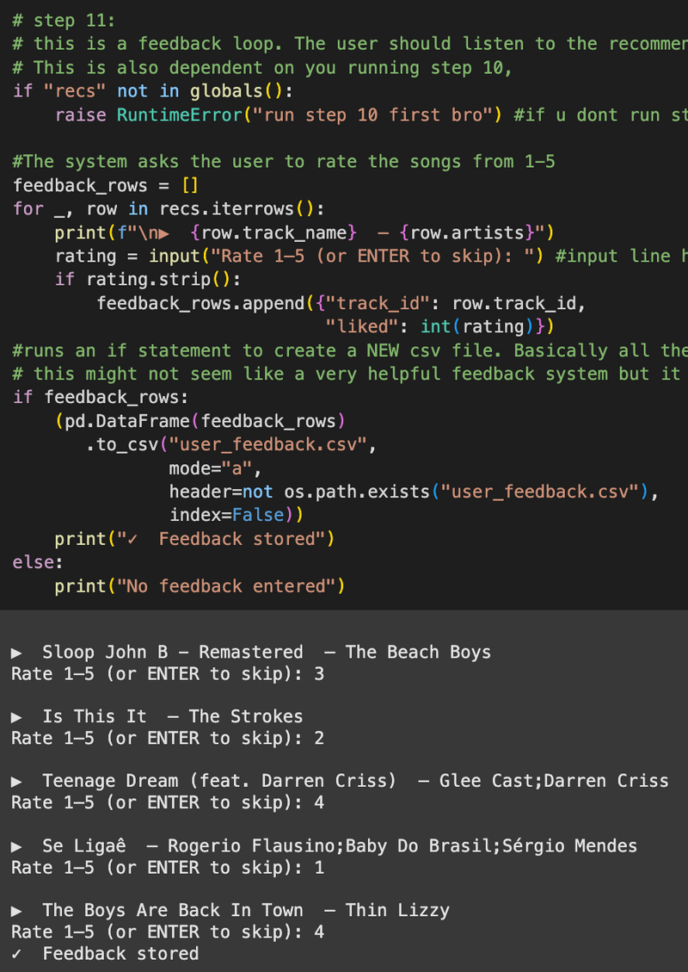
USER FEEDBACK
SYSTEM
After generating recommendations, the system asks users to rate each suggested song from 1 to 5.
These ratings are saved to a file called user_feedback.csv, creating a basic feedback loop.
In the future, this data could be used to personalize the model, retrain it on user preferences, or build a hybrid recommender system.

Slide 7
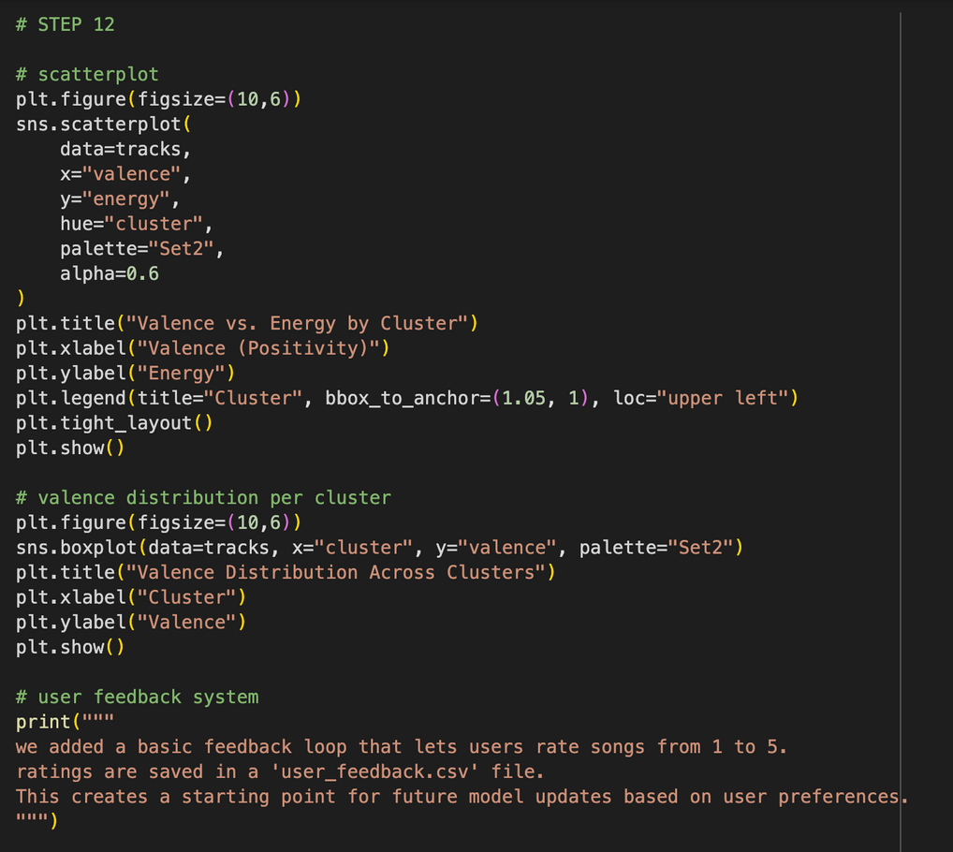
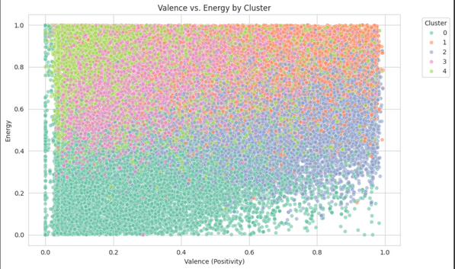
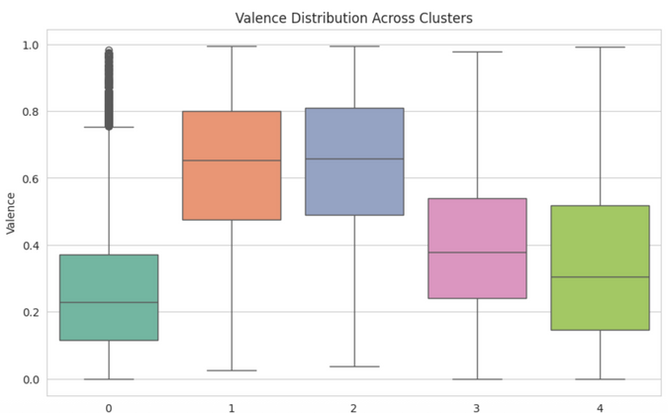
UNDERSTANDING VALENCE & FUTURE USER FEEDBACK INTEGRATION
To integrate feedback, we used the Valency of a song. Valence is a key audio feature that measures the emotional positivity of a song.
A low valence score reflects sadness or melancholy.
A high valence score indicated happiness or cheerfulness. By analyzing valence, our model can group songs with similar moods, imporving emotional consistency in recommendations.
In the future user feedback can be incorporated to enhance the model.
This may include:
Likes, skips or song ratings
Time spent listening to a track
Repeat listening behavior

Slide 8
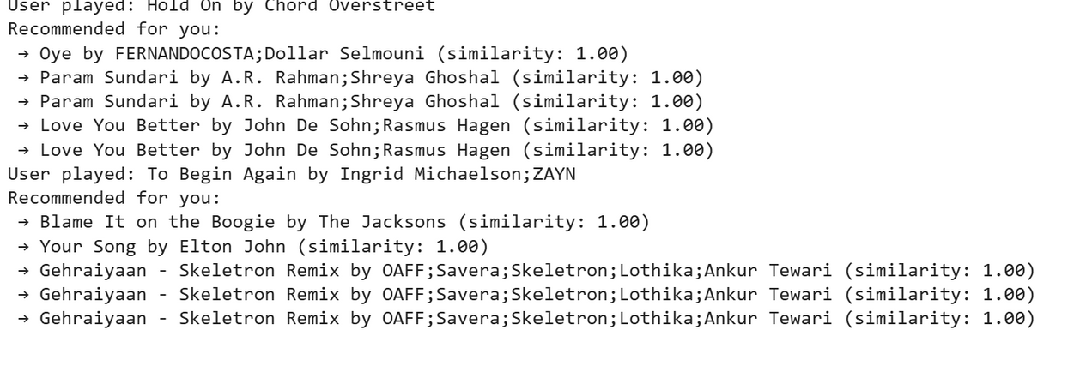
Innovation
A Real Time Recommendation system
This system uses the elements of the last song played by the user to find similarity and recommend a similar song for the next song
Helps give better recommendations for users
Finds the most similar song out of every song on spotify

Slide 9
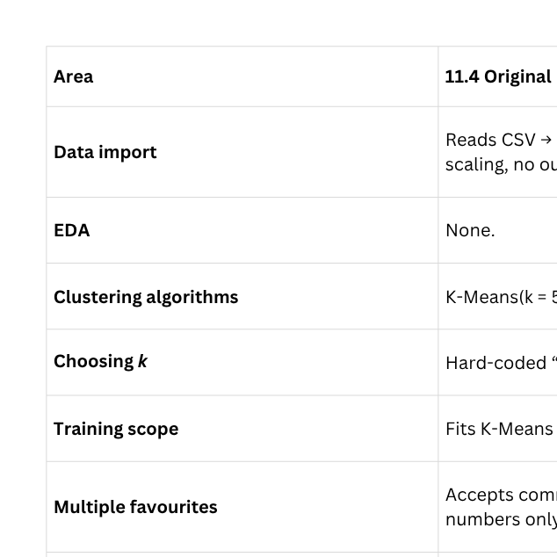
NEW MODEL
COMPARISON

